Slide 1
Quick Intro: Attention Heads and Transformer Layers
Paul Rodriguez PhD
2023

Slide 2
Outline
Basic word prediction task and motivating the attention strategy
A basic Attention Head network
Transformers
Exercise: Working with BERT pretrained transformer model

Slide 3
Dependences of Language
Consider this sequence:
The Law will never be perfect, but it’s application should be just - this is what we are missing, in my opinion <End of Sequence>
What does ‘it’ refer to that can have an ‘application’?

Slide 4
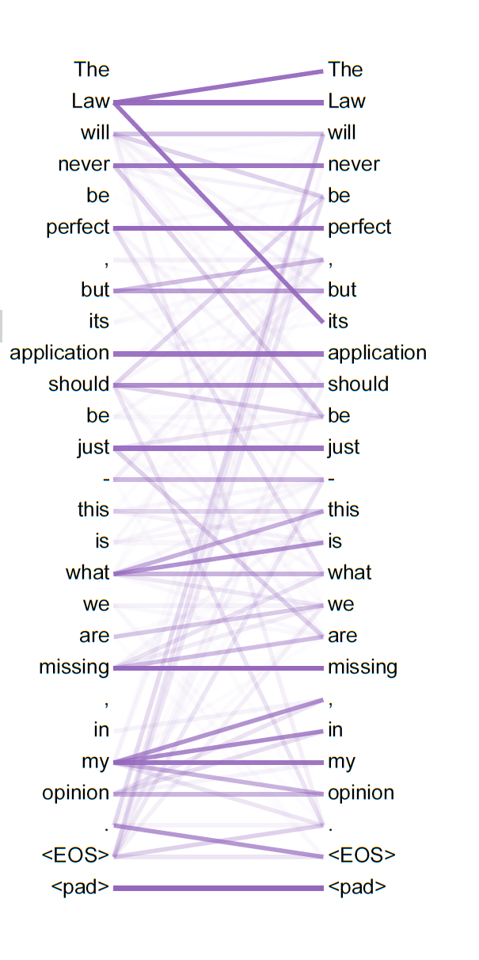
Dependences of Language
Consider this sequence:
The Law will never be perfect, but it’s application should be just - this is what we are missing, in my opinion <End of Sequence>
What does ‘it’ refer to that can have an ‘application’?
e.g ‘it’ refers back to ‘Law’, which is part of ‘the Law’ noun phrase, which is the entity that will ‘never be perfect’, and so on …
many dependencies and interactions

Slide 5
A toy problem to get some intuition
Let's use the following list of 5 tokens:
<start>, the, man, chicken, ordered
Let's use this sequence of 6 tokens as our only:
<start> the man ordered the chicken
If we use token ids 1 to 5 it is the sequence of 6 numbers [1,2,3,5,2,4]
Now let's try to predict the next word by 'attention' idea

Slide 6
The toy task: predict next word
The data: 5 tokens (V=5),
1 sequence (length=T=6): <Start> the man ordered the chicken
A basic solution is bigram matrix
eg a sequence of tokens (rows) and current word predictions (cols)
X= Sequence-to-Word is TxV
Pos | Word | <strt> | The | Man | Chikn | Order.
0 | <start> |  | 1.0
1 | The |  |  | 0.5 | 0.5
2 | Man |  |  |  |  | 1.0
3 | Orde.r |  | 1.0
4 | The |  |  | 0.5 | 0.5
5 | Chick. | 1.0

Slide 7
The toy task: predict next word
The data: 5 tokens (V=5),
1 sequence (length=T=6): <Start> the man ordered the chicken
A basic solution is bigram matrix
eg a sequence of tokens (rows) and current word predictions (cols)
X= Sequence-to-Word is TxV
Pos | Word | <strt> | The | Man | Chikn | Order.
0 | <start> |  | 1.0
1 | The |  |  | 0.5 | 0.5
2 | Man |  |  |  |  | 1.0
3 | Orde.r |  | 1.0
4 | The |  |  | 0.5 | 0.5
5 | Chick. | 1.0
Challenge, can we learn predictions (→) that depend on context of other tokens and/or position
After <Start> the→ man = 1.0
After ‘Ordered’ the → chicken = 1.0

Slide 8
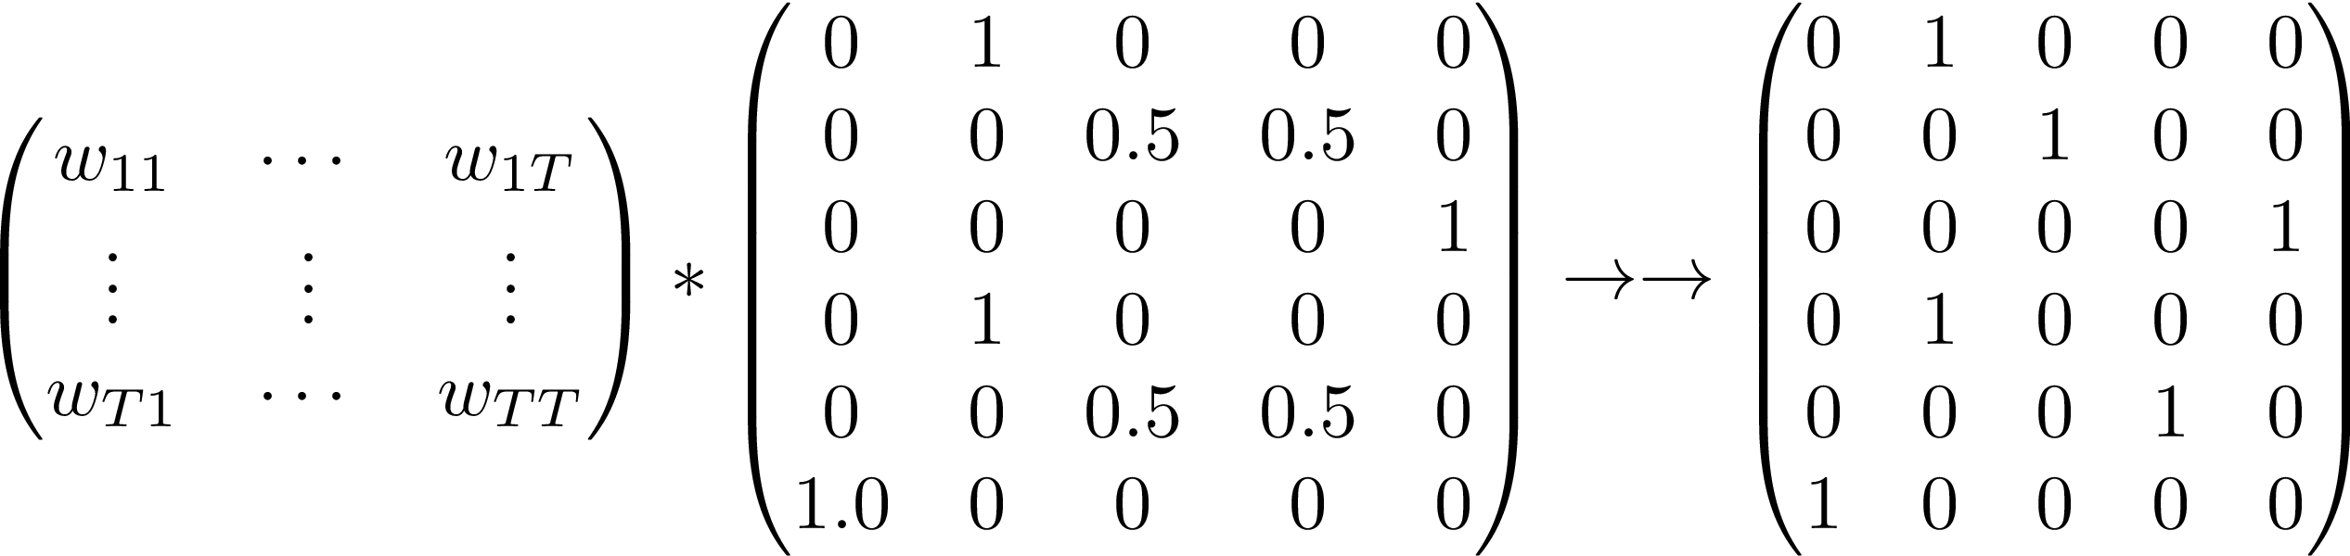
The attention idea
Let’s get all tokens to ‘pass information’ about dependencies
E.G. for X a TxV matrix, we want W a TxT matrix – aka ‘attention’ weights -
so that W*X=TxV has contextual predictive information
W dependencies is TxT
X= Sequence-to-Word is TxV

Slide 9
The attention idea
Let’s get all tokens to ‘pass information’ about dependencies
E.G. for X a TxV matrix, we want W a TxT matrix – aka ‘attention’ weights -
so that W*X=TxV has contextual predictive information
W dependencies is TxT
X= Sequence-to-Word is TxV
W will be learned and should depend on transformations of X

Slide 10
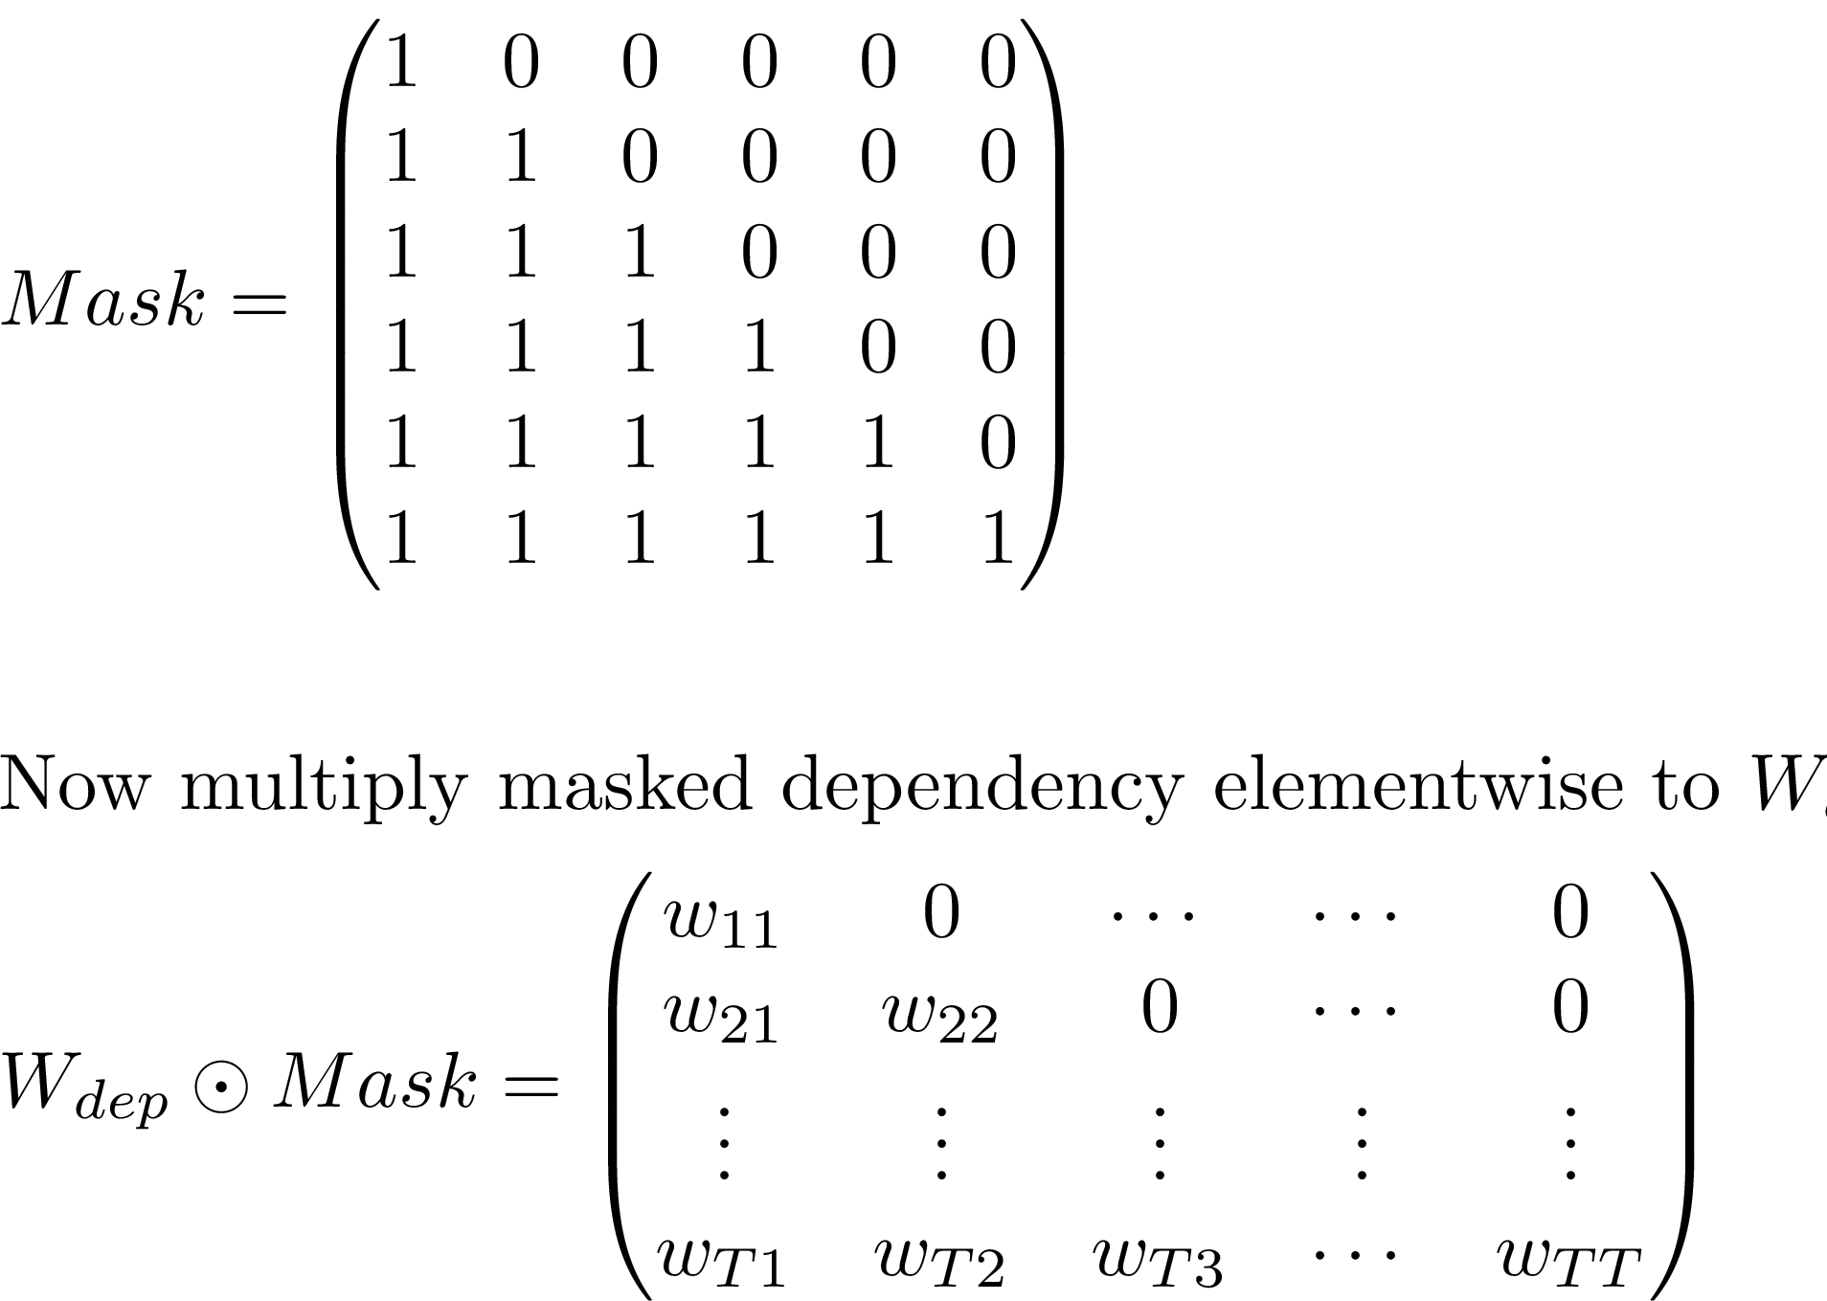
Making predictions causal
(ie only depends on previous tokens)
First build a TxT mask so that sequence position t only uses columns 1:t
Then, multiply it by W_dep matrix
Finally, apply Softmax to each row to make it like probability weights

Slide 11

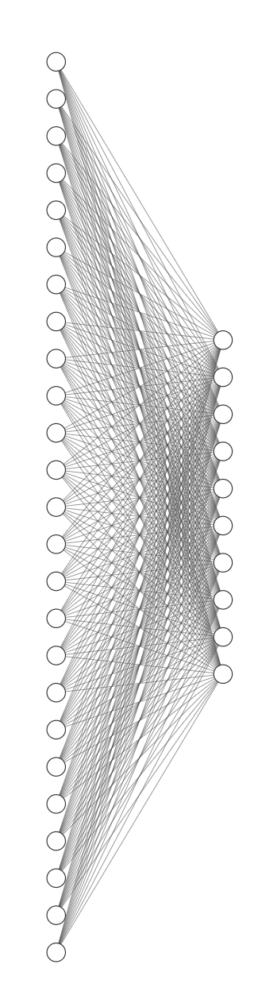
Transformation as Embedding Layer/Table
0
0
.
.
.
0
1
0
.
.
.
0
0
Let X be given as a ‘one-hot vector input’ – where one of the 25 input nodes is 1, the rest are 0.
Use linear activation so that
X is 25x1
Y is 10x1

Slide 12
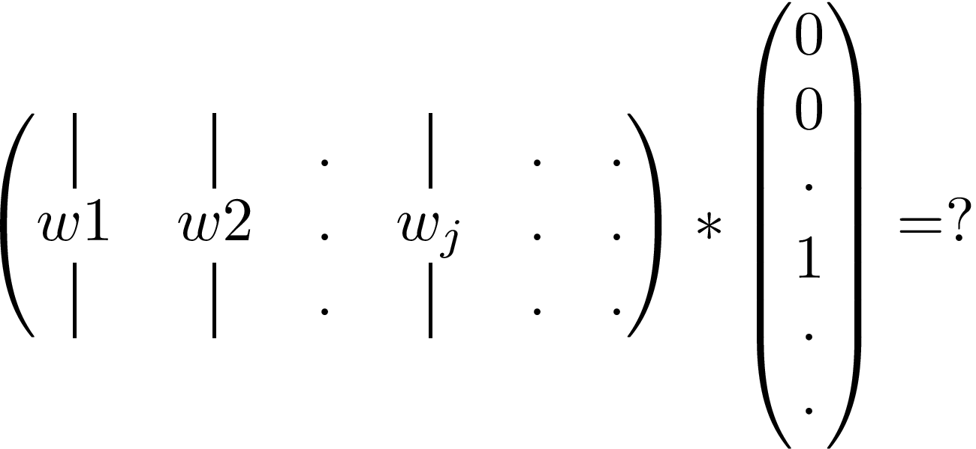
Transformation as Embedding Layer/Table
0
0
.
.
.
0
1
0
.
.
.
0
0
Let X be given as a ‘one-hot vector input’ – where one of the 25 input nodes is 1, the rest are 0.
Use linear activation so that
If j-th node is 1, then for W a 10x25 matrix
X is 25x1
Y is 10x1

Slide 13
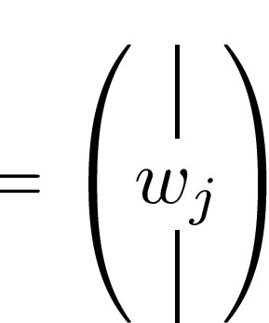
Transformation as Embedding Layer/Table
0
0
.
.
.
0
1
0
.
.
.
0
0
Let X be given as a ‘one-hot vector input’ – where one of the 25 input nodes is 1, the rest are 0.
Use linear activation so that
if j-th node is 1, then for W a 10x25 matrix
X is 25x1
Y is 10x1
So just let X be sequence of token ids and treat W like a table

Slide 14
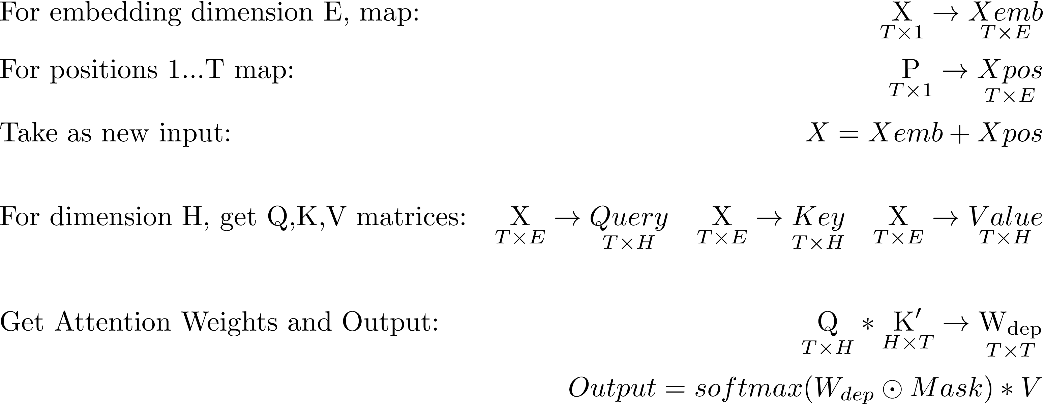
An Attention Head construction
1. Let X = sequence of token ids
2.
3.
All mappings are linear transformations

Slide 15
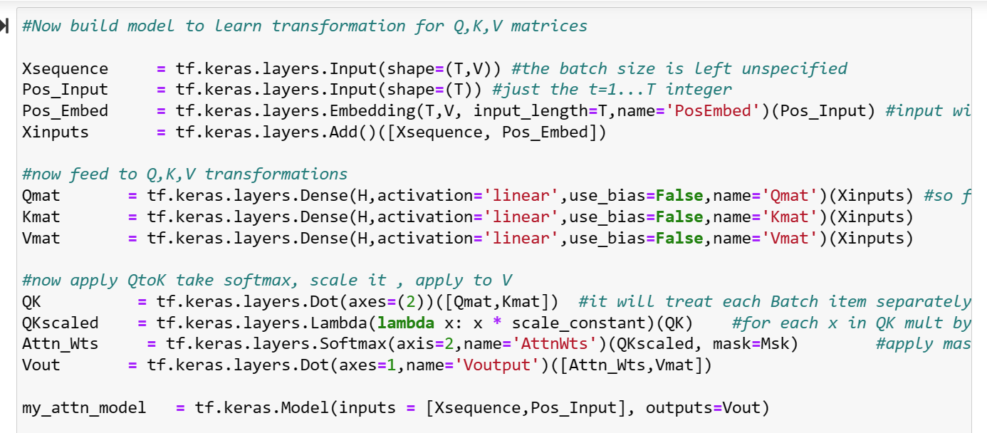
An Attention Head code
Hyperparameters:
E is for embedding dimension,
H is for “head size” (dimension) of transformations (we could let E = H)
11 Layers/Functions

Slide 16
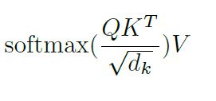
An Attention Head code
Hyperparameters:
E is for embedding dimension,
H is for “head size” (dimension) of transformations (we could let E = H)
11 Layers/Functions
Also a scaling by H

Slide 17
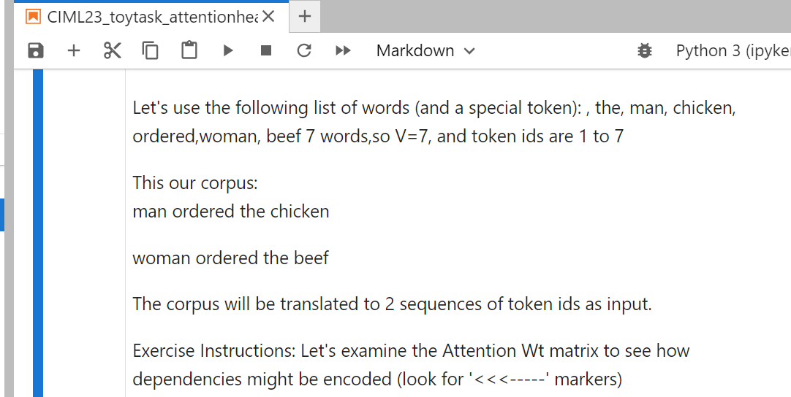
An example of attention head with a toy task:
(in the CIML23_toytask_attention notebook)

Slide 18
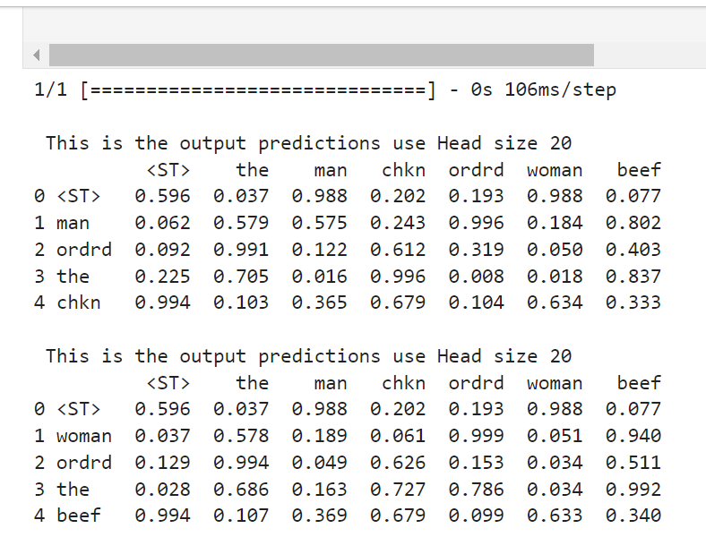
Output TxV predictions:
Notice that the→ [chicken or beef] predictions change

Slide 19
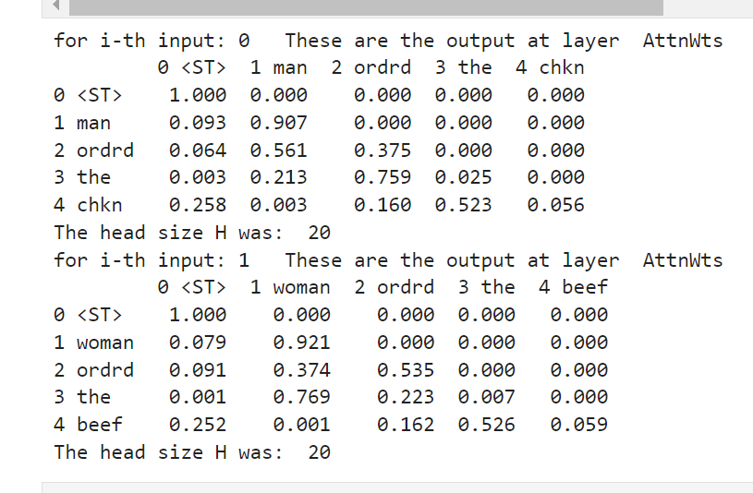
Output TxV predictions:
Notice that the→ [chicken or beef] predictions change
TxT Attn Wts:
Notice that the ← wts
are from [ordered or man]

Slide 20
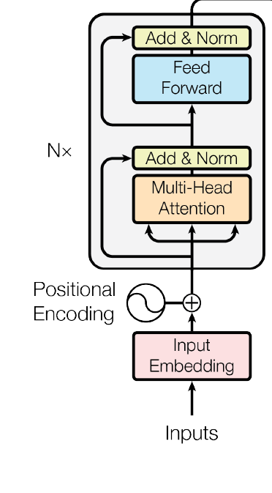
Finally, a transformer
Include skip-add connections
Include Layer Normalization or DropOut layers

Slide 21
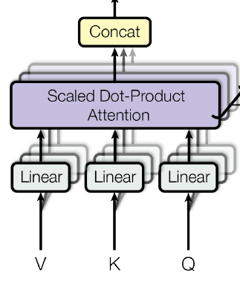
Finally, a transformer
Include skip-add connections
Include Layer Normalization or DropOut layers
Multi-Head – for N heads produce Tx(H/N) each

Slide 22
Finally, a transformer
TxE
Include skip-add connections
Include Layer Normalization or DropOut layers
Multi-Head – for N heads produce Tx(H/N) each
Add MLP layers on top –
output another TxE matrix
stackable!

Slide 23
Finally, a transformer
TxV or num_classes
TxE
Include skip-add connections
Include Layer Normalization or DropOut layers
Multi-Head – for N heads produce Tx(H/N) each
Add MLP layers on top –
output another TxE matrix
or output final probabilities
stackable!

Slide 24
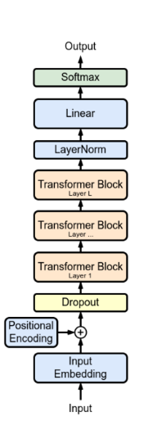
2 kinds of training strategies
GPT – predict next word only look back at prior context (which could be a whole document)
Put mask on attention weights so that predictions only depend on previous tokens
BERT – No attention mask so all token dependencies can influence all other tokens predictions
Special tokens help create a variety of tasks

Slide 25
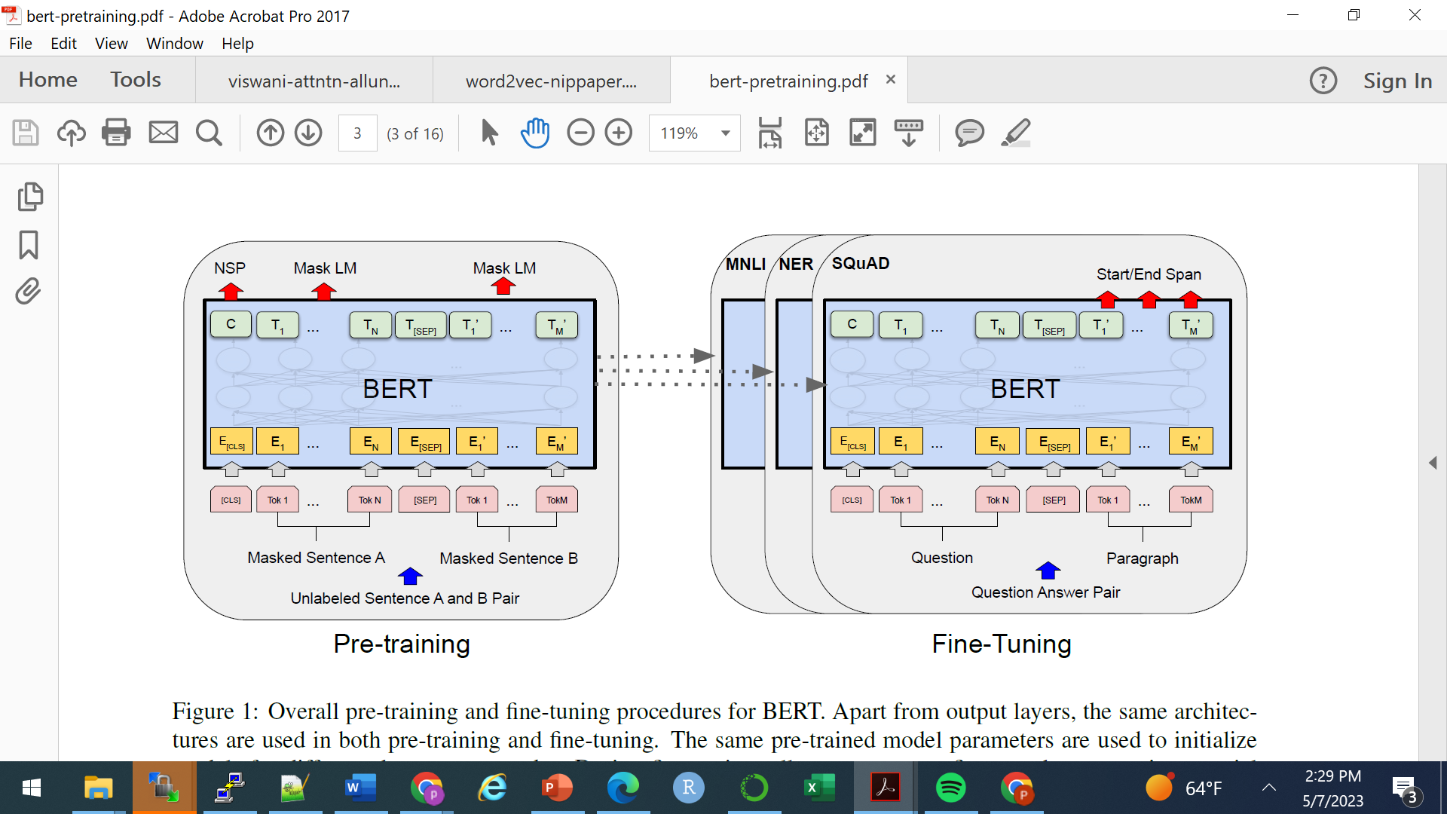
BERT (Bidirectional Encoder Representations from Transformers)
Goal: Train a model to develop general token-level AND sentence-level encoding
1 Pretrain on:
- fill-in-the-blank
- binary classification if 2 sentences go together
2 Fine tune on variety of tasks
Devlin, etal, 2019

Slide 26
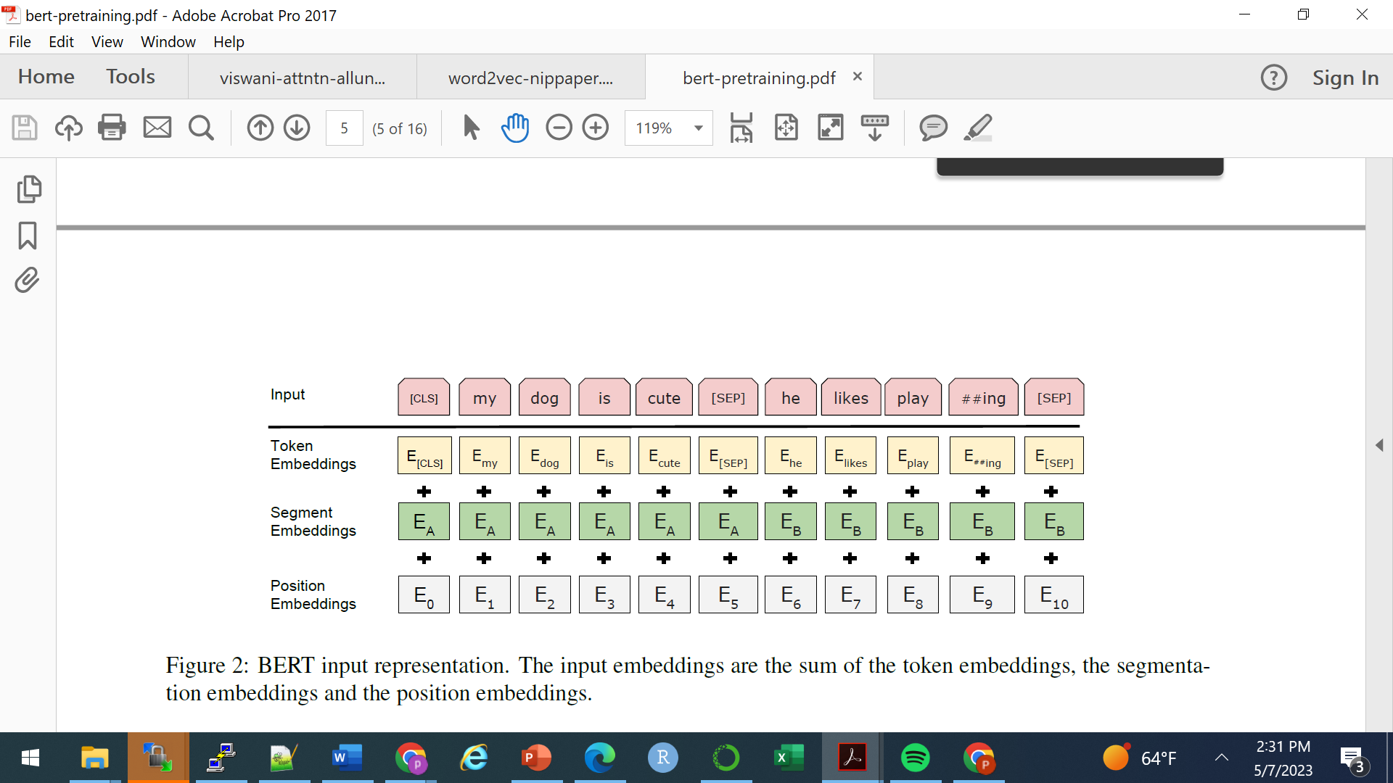
BERT Input: 2 sentences
[CLS] is’dummy’ token and always present
[PAD] tokens help fill out sequence to T items
[SEP] marks separation between sentences or sequences
Devlin, etal, 2019

Slide 27
BERT Input: 2 sentences
[CLS] is’dummy’ token and always present
[PAD] tokens help fill out sequence to T items
[SEP] marks separation between sentences or sequences
Add a TxE matrix for ‘A’’ vs ‘B’ sentence

Slide 28
Last layer TxV output
BERT –
Transformer Layers
Embeddings
T Input tokens
[CLS] is’dummy’ token and always present
Devlin, etal, 2019

Slide 29
Train a classification task on this [CLS] token prediction only
BERT –
For classification over paired sentences or any text, train C row vector (in the last layer TxV output matrix)
“NSP”: classify if next sentence follows first sentence
[CLS] is’dummy’ token and always present

Slide 30
KerasNLP
KerasNLP is an extension to Keras
KerasNLP has several pre-trained LLMs (large language models). Each model comes with related modules, for example:
GPT2Backbone the model without task specific output layers
GPT2CausalLM the model with output predictions
GPT2CausalLMPreprocessor the preprocessor that feeds model.fit

Slide 31
KerasNLP
KerasNLP is an extension to Keras
KerasNLP has several pre-trained LLMs (large language models). Each model comes with related modules, for example:
GPT2Backbone the model without task specific output layers
GPT2CausalLM the model with output predictions
GPT2CausalLMPreprocessor the preprocessor that feeds model.fit
We will use pre-trained BERT and compare different BERT versions

Slide 32
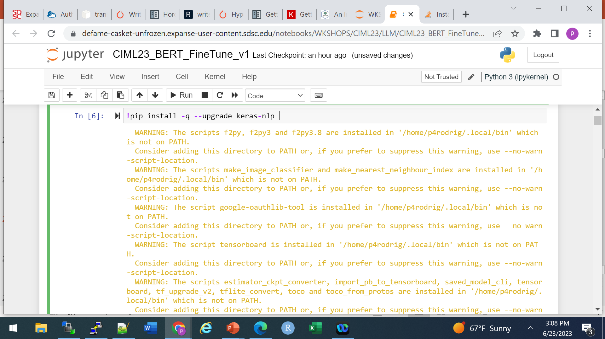
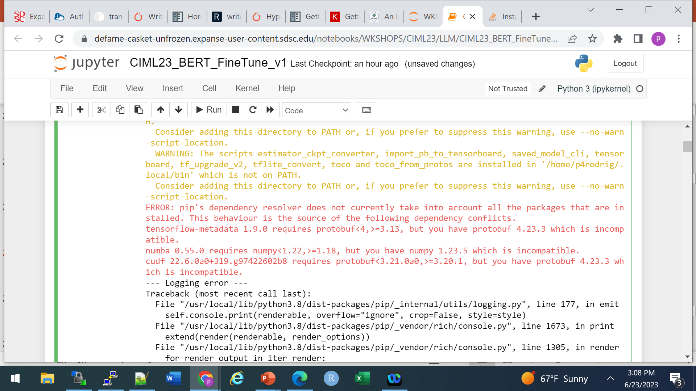
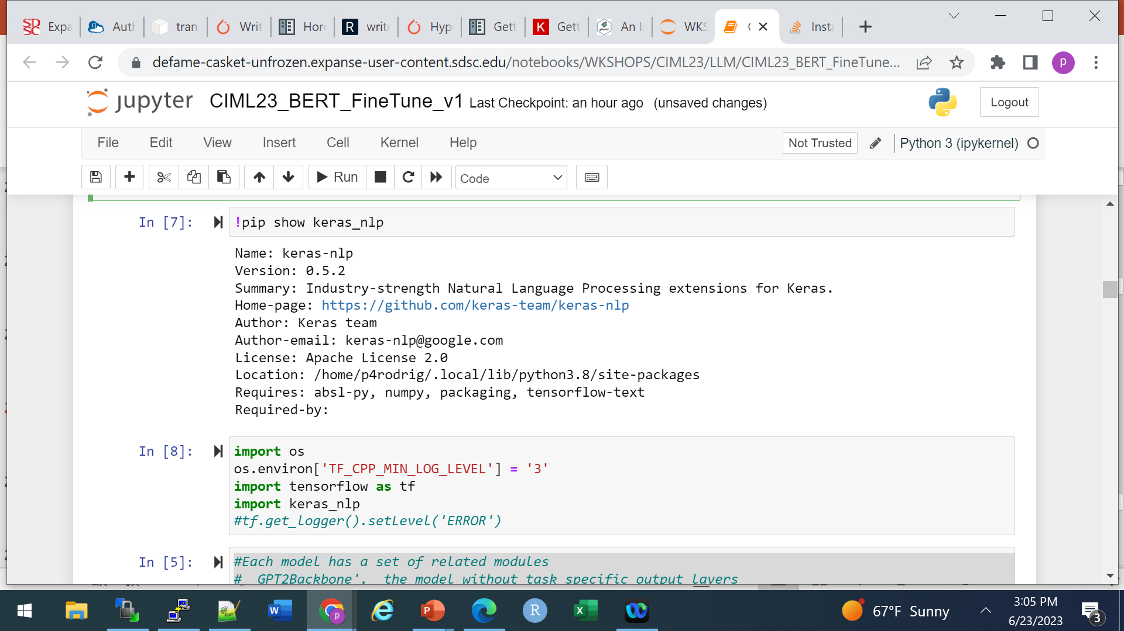
Keras NLP package is not in the tensorflow container, so we can do:
1. Rebuild Container - check
2. Set up conda environment
3. Run ‘pip install’ commands
Option 3 is quick and a bit dirtier, but often useful and part of tutorials
On Expanse you might get warnings or logging errors.
But it should show the package as installed
Note, ‘pip install’ will put packages in .local directory which is on PythonPath. So there’s a potential to clash with other notebooks – you may have move/manage your .local directories

Slide 33
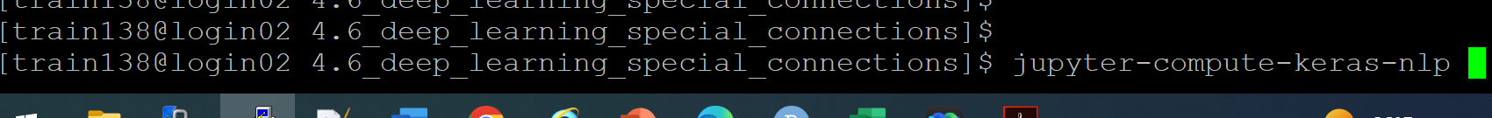
Notebook exercise using KerasNLP
In a terminal window start the notebook session for keras-nlp
…]$ cd 4.6_deep_learning_special_connections
…]$ jupyter-compute-keras-nlp
Open the URL and look for the CIML23_BERT_FineTune_v3.ipynb notebook

Slide 34
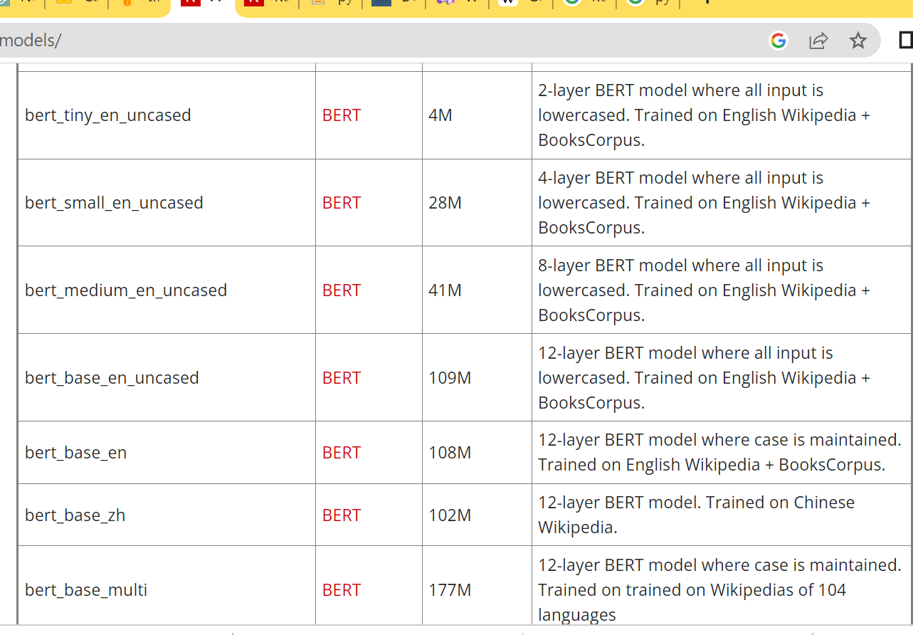
Keras NLP package has several BERT versions
So let’s start with ‘bert-small’ (28M parameters)
For reference:
BERTBASE (L=12, H=768, Attn=12, Total Parameters=110M)
BERTLARGE (L=24, H=1024,
Attn=16, Total Parameters=340M).

Slide 35
END

